Slide 1

Financial Umbrella
For Every Indian

Slide 2
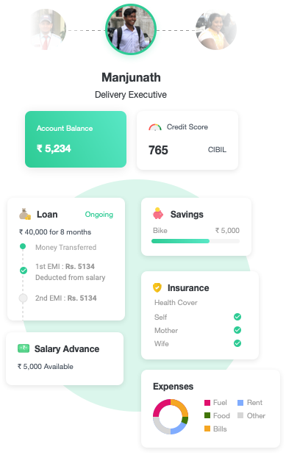
Our Vision
Financial umbrella for every Indian
Financial access and transparency on one platform
Payroll and employment linked financial account for every user
Offer a range of products on top of payroll info/data
Multiple entry points into user’s financial journey

Slide 3
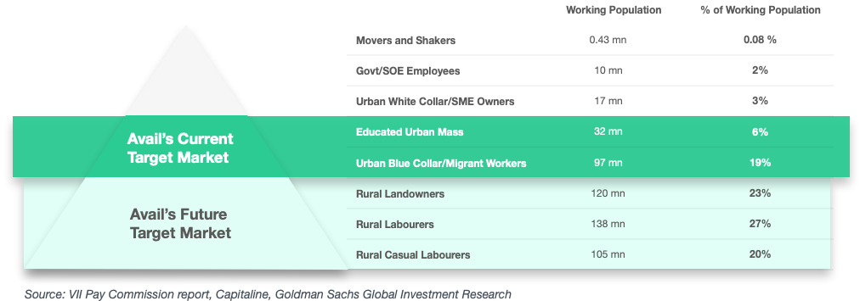
Target Segment
Currently targeting the Urban Mass, making up more than 25% of workforce
Customer Profile

Slide 4
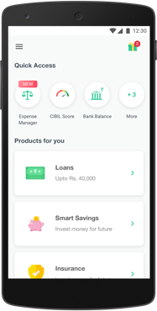
Avail Today
Product Offerings
4.1
Loans
Insurance
Play Store Rating
Savings
Credit Score
Reporting
2.5 Million
Expense
Management
Bank Balance
Tracking
Total downloads
Salary
Account*
Notes:
- Change Icon

Slide 5
Partnerships
Nearly 50 active corporate partners, including all major gig players enabling outreach to more than 1.5 million employees

Slide 6
Unique About Us
Low CAC
Sachetized financial
B2B partnership and digital first acquisition driving CPI to INR 19.8
products
Customized Collections
Loans
- Free salary advances with tip based repayment - Flexible repayment structure - Quick and easy short-term loans
- Deduction by employer reduces the cost of the collection.
- Daily/Weekly/Monthly EMI plans based on income frequency.
Insurance
- Micro Insurance Plans based on job type and lifestyle - Monthly premium to make it pocket friendly
Profile Specific Risk
Risk assessment specific to the blue collared segment based on their employment and engagement data.
Savings
- Target based - Liquid and easily accessible

Slide 7
Credit Process built for the Blue-Collared
The Avail Score is able to differentiate Good vs Bad customers (specific to the target segment of Avail better than the CIBIL score
Avail Score was built using the customer's different characteristics relating to the repayment behaviour, focused on only Avail customers
While CIBIL score was built using entire population that CIBIL hold, which is loosing the differentiation behaviour in Avail's customer segment (Zig-Zag trend)
Notes:
For Data (check with Khatod if this can be shared)

Slide 8
Founding Members
Advisors
TVG Krishnamurthy
Hindol Basu
40+ years of global experience
Worked in Grindwell Norton, Kalbe Pharma,
Cadbury
Mentor & Advisor to Ola, CoCubes, Belong
Alumnus: IIT Madras, IIM Ahmedabad
15+ years of experience
Worked in Citi, FICO, TransUnion
Alumnus: IIT Kharagpur,
IIM Bangalore
Ankush Aggarwal
Founder and CEO
Tushar Mehndiratta
Co-Founder and CTO
Alumnus of the University of Illinois,
Graduated with a Bachelor’s degree
in Computer Science
Launched Ola Auto in India.
Alumnus of IIT Roorkee,
Graduated with a Bachelors and
Master’s degree in Computer Science
Worked with Adobe for two years,
Filed three patents.
Hemant Kaul
Prof. Marti Subrahmanyam
30+ years of experience
Ex- CEO Bajaj Allianz General Insurance,
Executive Director, Axis Bank
40+ years of global experience
On boards of ICICI, Nomura, Infosys
Alumnus: Sloan MIT, IIM, IIT

Slide 9
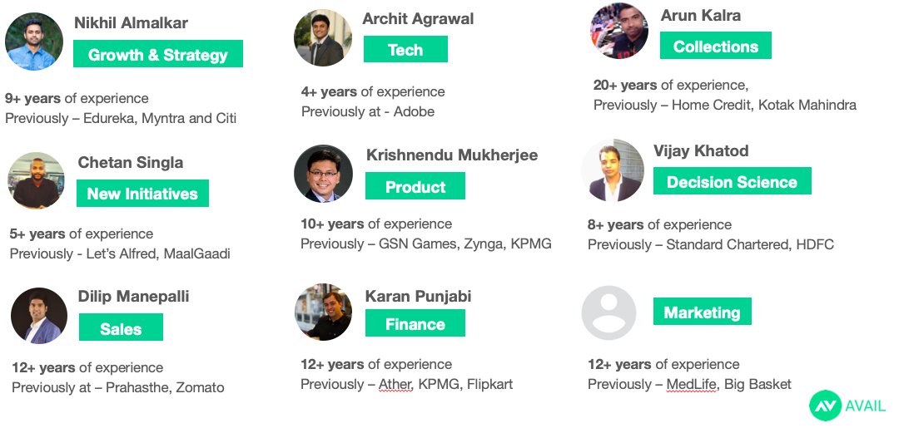
Team
Notes:
Add Charu’s details for Marketing – Bawal

Slide 10



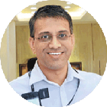
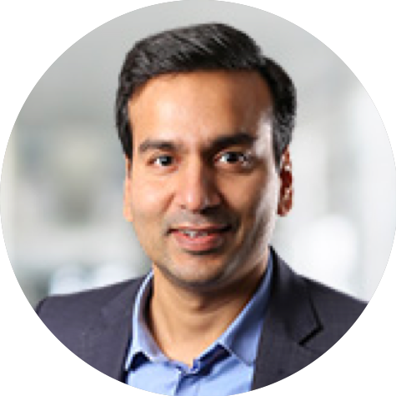





Existing Investors
Gaurav Deepak
Binny Bansal
Kunal Shah
Manish Patel
Notes:
Check with Karan

Slide 11
